Slide 1

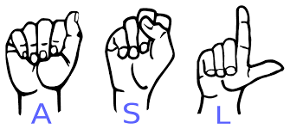
AMERICAN SIGN LANGUAGE RECOGNITION
PROFILING AND BIG DATA GROUP
Final Project Presentation using Python
SUBMITTED BY :
AMEYA PRASANNA MOTE : 3104966
AKASH MANE : 3105253
KAUSHAL DABHI : 3105065
NANMA JOSEPH : 3104969
PUJITHA PERI : 3103755
SURAJ NAIK : 3105252

Slide 2
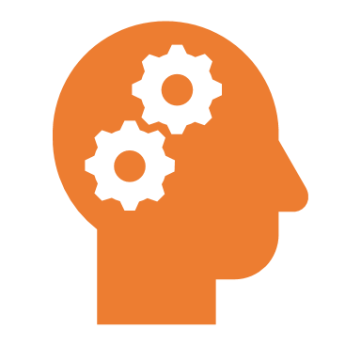


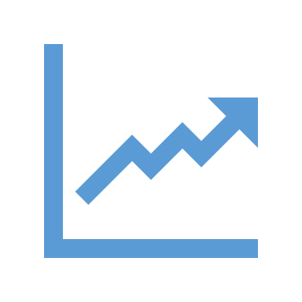

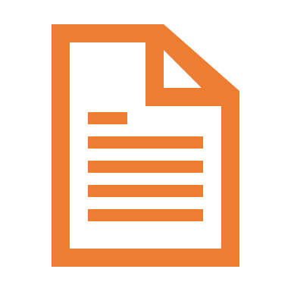


INDEX :
WHAT IS ASL?
THE OBJECTIVE
PROBLEM STATEMENT
MARKET OVERVIEW
SOLUTION
SIGN TO TEXT PROJECT
ANDROID APP FOR TEXT TO SIGN CONVERSION
REFERENCES

Slide 3
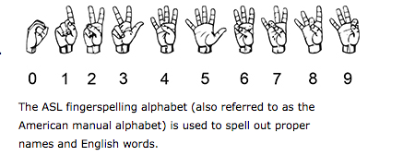
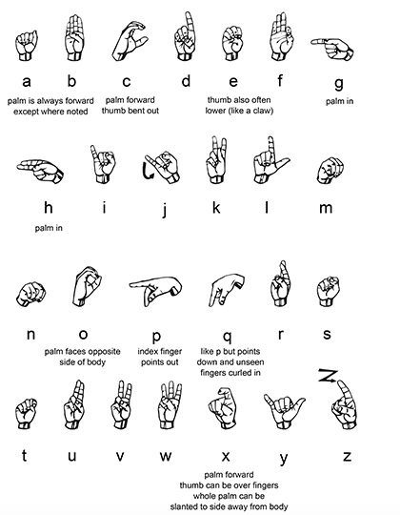
WHAT IS ASL ?
American sign language (ASL) is a natural language which uses hand gestures and facial expressions to help people communicate. It is different from the English language in terms of grammar.
ASL originated in the early 19th century in the American School for the Deaf (ASD) in West Hartford, Connecticut, from a situation of language contact.

Slide 4
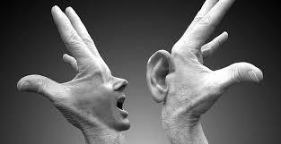
OUR OBJECTIVE :
Our objective is to build a low cost system with the help of a low cost hardware and an open source software to provide an accurate hand gesture tracking and recognition .

Slide 5
PROBLEM :
In our society we have people with disabilities.
The technology is developing day by day but there is no significant developments undertaken for the betterment of these people.
About 9 million people in the world are deaf.
Communication between Deaf-mute and a normal person has always been a challenge.
Sign Language helps Deaf-mute people to communicate with other people.
But not all understand Sign Language

Slide 6
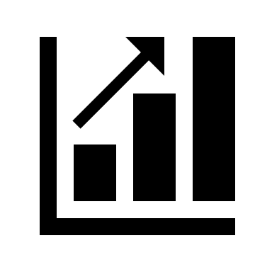
MARKET OVERVIEW
Deaf and mute gesture recognition system is an inexpensive device .
It is also very efficient device when compared to the existing devices .
The main objective of this project is to achieve communication of deaf – mute people like a normal person .
It does not require any additional controller or processor .

Slide 7
SOLUTION :
Hand gesture recognition system is widely used system in technology for helping the deaf and mute people .
Human hand has remained a popular choice to convey information in situations where other forms like speech cannot be used .
We aim for developing an deaf and mute gesture recognising system for establishing communication between the deaf and the mute people .
Gestures are considered as the most natural expressive way for communications between human and computers in virtual system .
Hand gestures which can represent ideas using unique shapes and finger orientation have a scope for human interaction

Slide 8







PART 1 : SIGN TO TEXT
STEP 1: TECHNOLOGY
PYTHON , KERAS , NEURAL NETWORK (CNN) TO TRAIN IMAGES
STEP 2: GATHERING DATASET
DOWNLOAD DATASET OF HAND SIGN LANGUAGE FROM KAGGLE AROUND 27000 TEST AND TRAIN IMAGES.
STEP 3: IMPLEMENTATION
ASL OUTPUT
RECOGNISE
CREATE A RECOGNITION PROGRAM TO DETECT THE HAND AND IMPLEMENT THE MODEL GENERATED.
STEP 4: SIGN-TO-TEXT
DEVELOP MODEL.

Slide 9
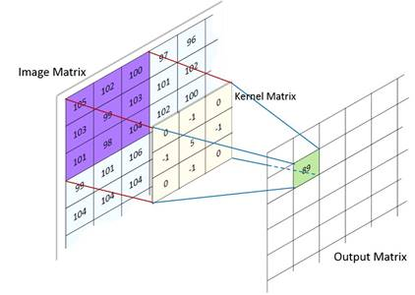
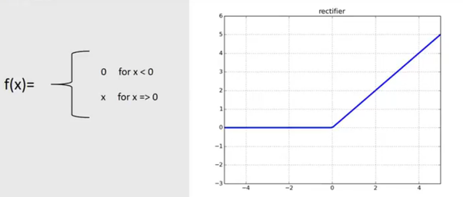
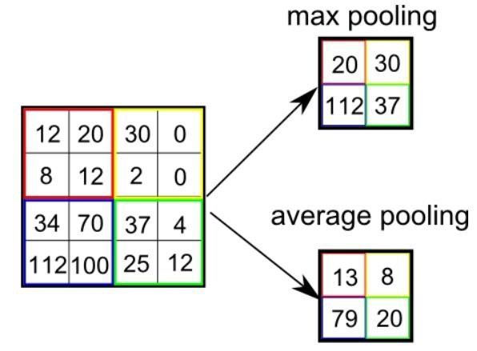
MODEL :

Slide 10
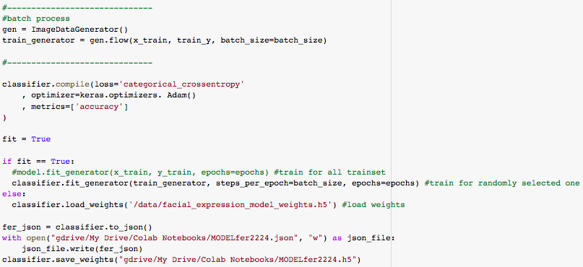
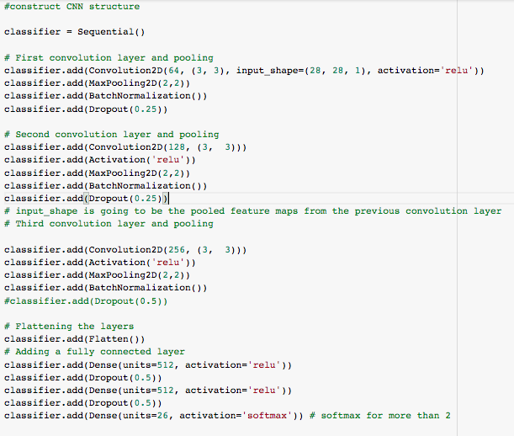
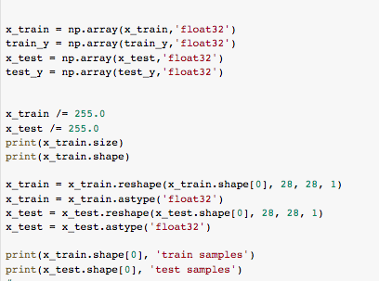
MODEL CODE :

Slide 11
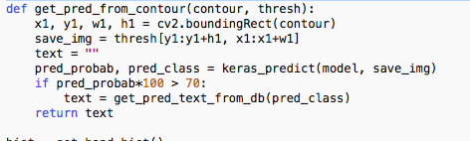
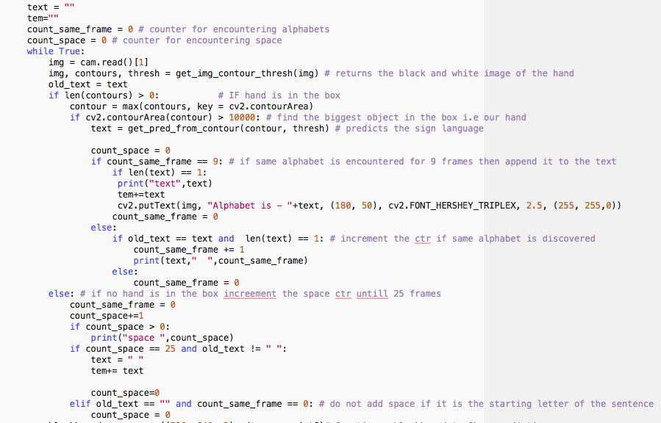

RECOGNITION CODE :

Slide 12
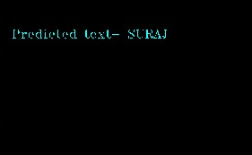
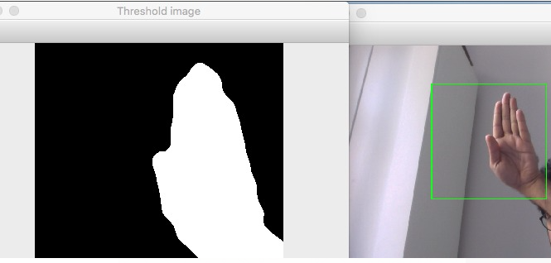
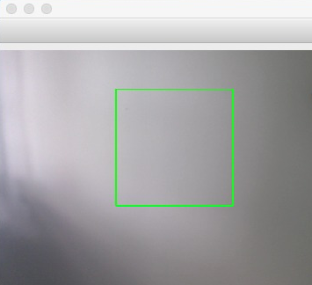
USER INTERFACE :
Recognizing Window to take Input

Slide 13
FUTURE SCOPE :
This device can be developed into a device that includes various sign languages in different countries .
We want to make it into a complete product that makes the deaf and mute people to communicate like a normal people .

Slide 14

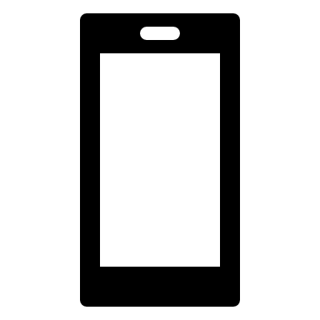
ANDROID APP FOR TEXT TO SIGN CONVERSION :
WORKING
Since this is the first version of this project, a basic GUI was developed which housed the database we rely on, i.e., ASL. A square box is given which acts as an input.
The user can type in the sentence that he wants to convey in sign language to another person.[5] As of now, the only accepted input is in English language.
There is also a mic option with which instead of writing a text, the user can simply speak into the phone. Once the required speech or text is used as an input, one only has to push the Translate button so as to show it’s equivalent sign language.
The interface has deliberately been made simple so as it can be used by person from any walk of life.

Slide 15
WHY ANDROID STUDIO ? :
At present, more than 76.6% of the Smartphone’s, including HTC, LG and Samsung Models use Android as their operating system (OS), and expecting that Android will be in smart watches, laptops, car very soon.
Eclipse actually could not challenge Android Studio since it was designed in a different way in different times.
App developers can use Eclipse for distinctive platforms or for a group of different programming languages .
Whereas , AS is designed particularly for Android development and to accelerate the android application development process and making it simpler is the prime aim of this IDE.

Slide 16
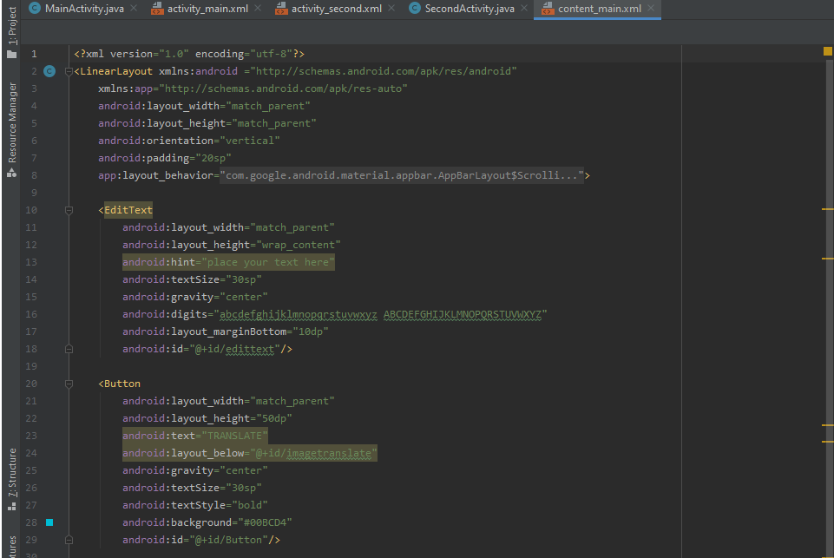
Here we are firstly providing a linear basic layout for the app .
Assigning its width , height , padding , and orientation
Inserting a text holder , button for the translation and also a mic for the input speech .

Slide 17
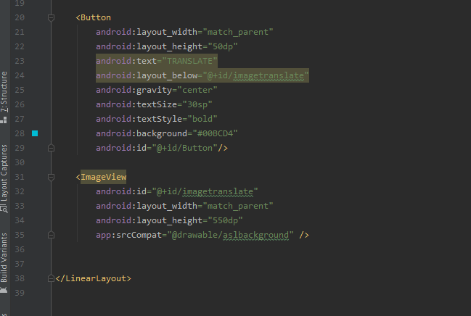
Inserting the image view .

Slide 18
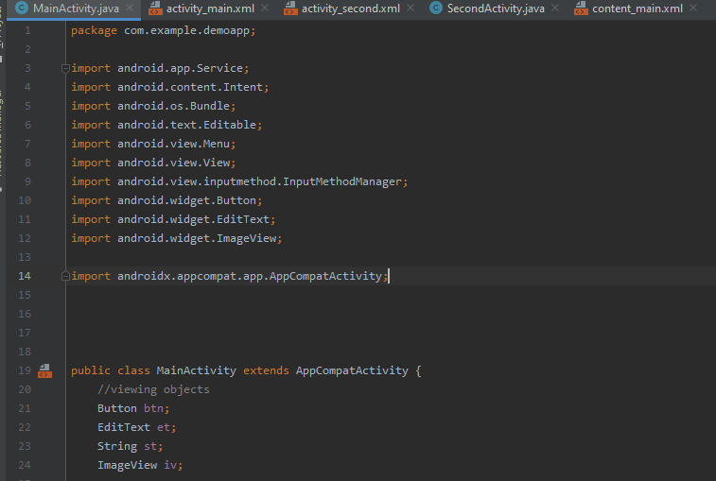
CODE :

Slide 19
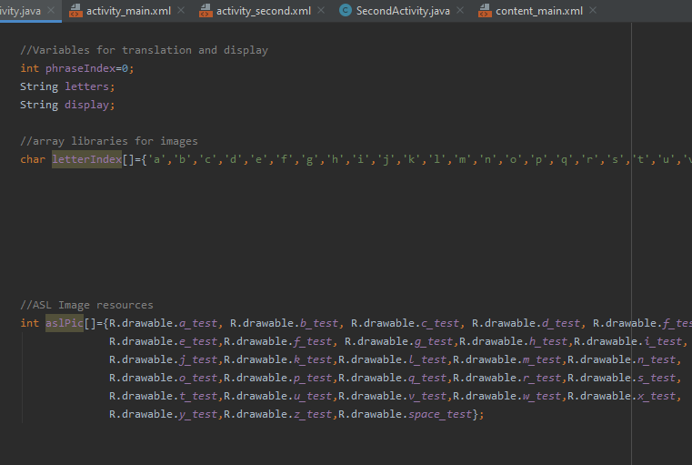
Assigning all the images from the drawable folder in order to access them .

Slide 20
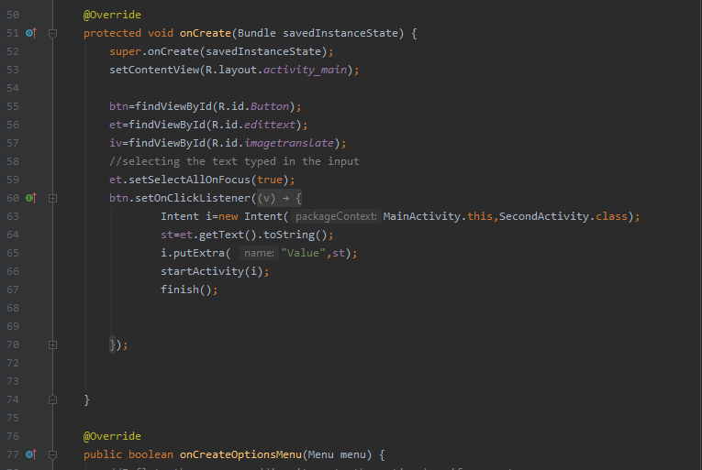

Slide 21
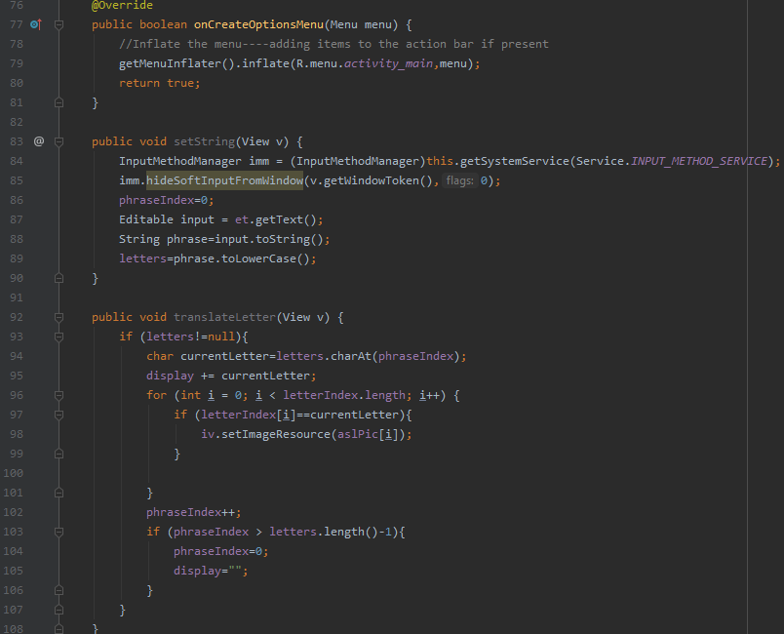
CODE :

Slide 22
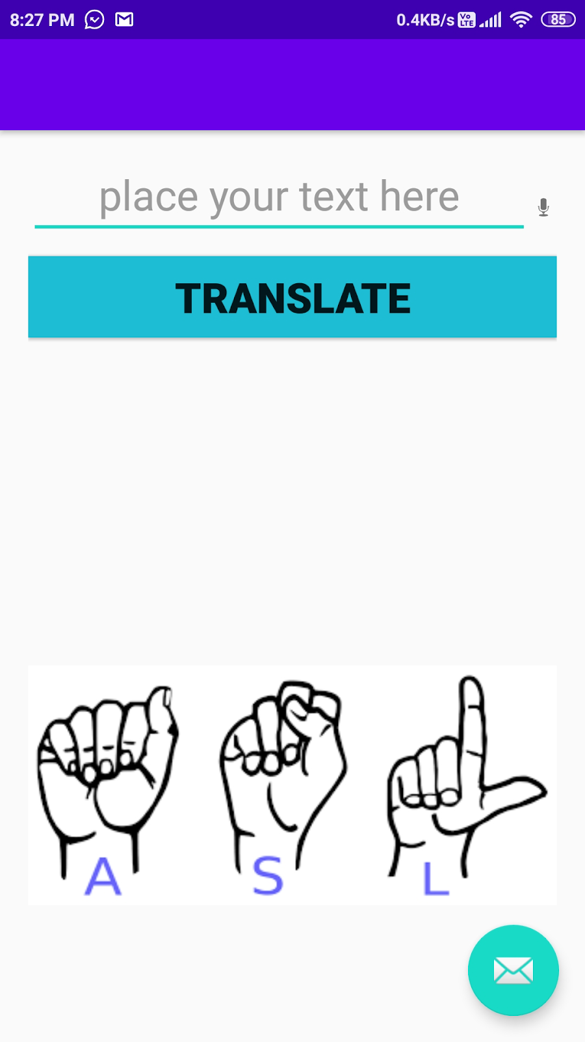
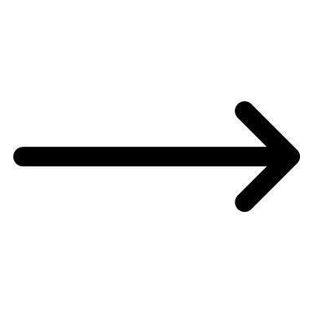
SCREEN 1:
Type your text
Microphone for Speech input

Slide 23
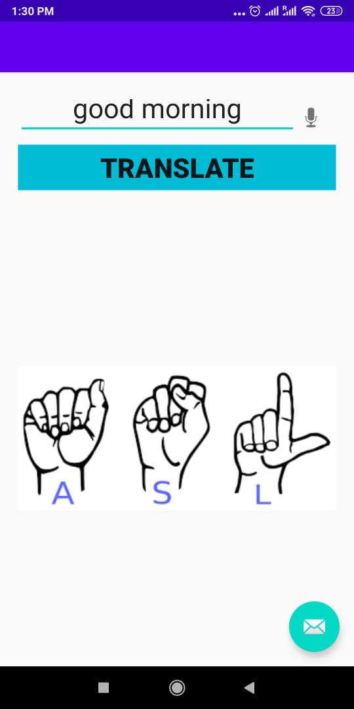
SCREEN 1 :
Input a normal text " good morning " into the space provided .

Slide 24
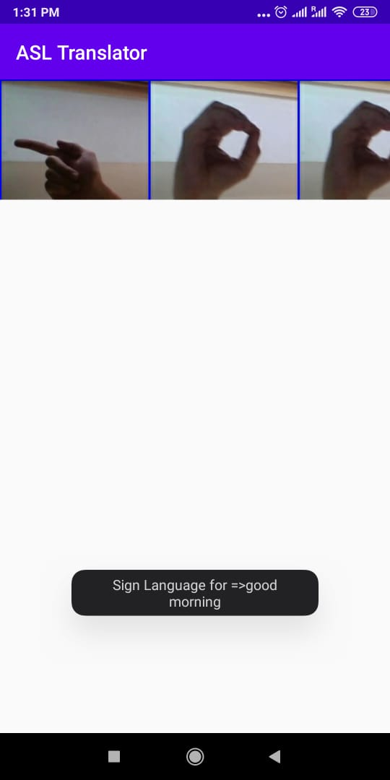
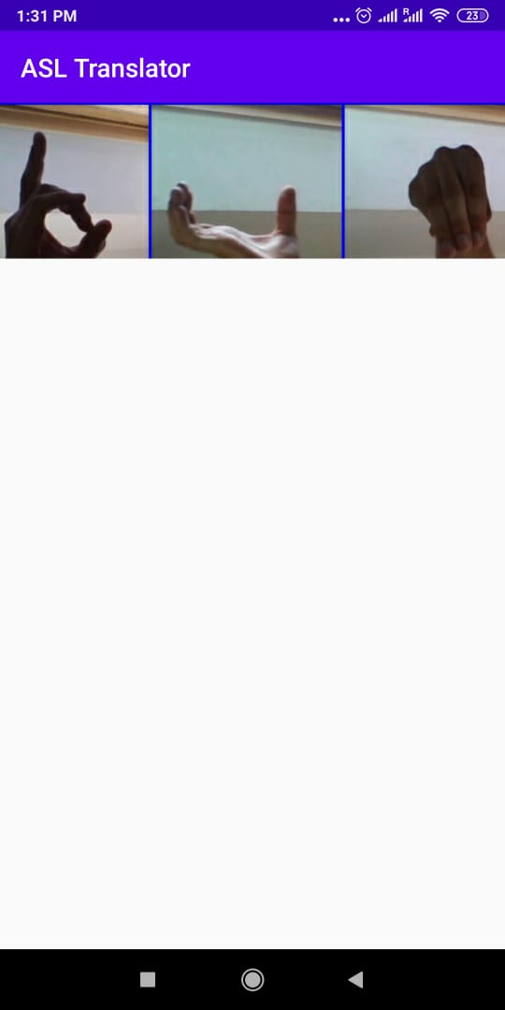
SCREEN 2 :
Corresponding sign image for the text is displayed .
The rest of the images are displayed using a slider so that we are able to scroll the images .

Slide 25
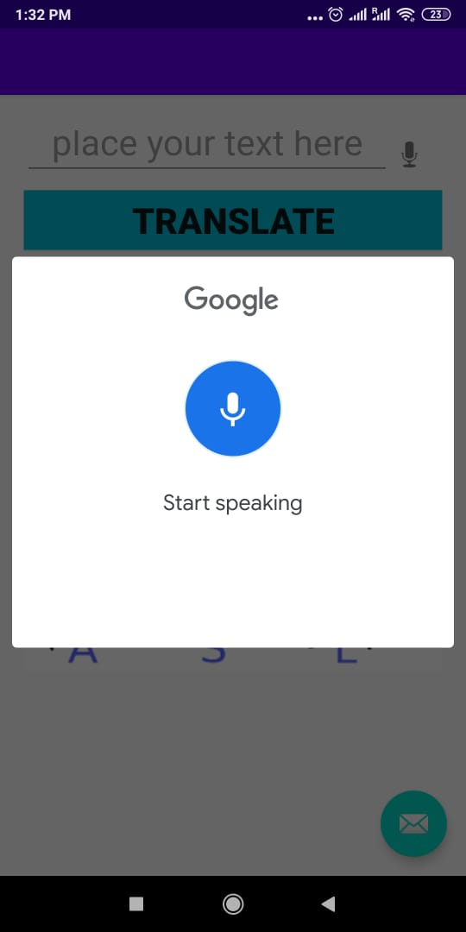
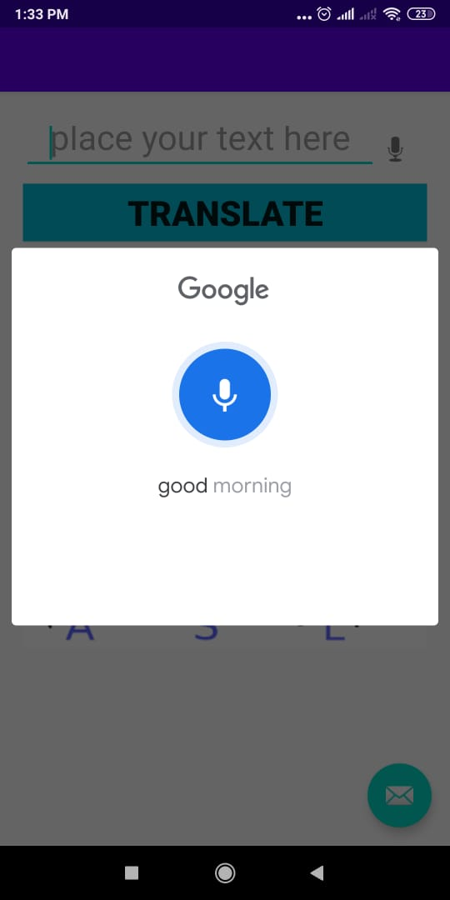
SCREEN 1 :
INPUT THROUGH SPEECH

Slide 26
APP DEMO VIDEO
https://drive.google.com/file/d/1DON9t478t-QrZv8-bHMClwuThC0Cjp7h/view?usp=sharing

Slide 27
REFERENCES :
https://dzone.com/articles/why-android-studio-better
https://wecapable.com/tools/text-to-sign-language-converter/
https://funtranslations.com/sign-language
http://www-cs.engr.ccny.cuny.edu/~csjie/cap/f16_des_pres/SignLanguageTranslator.pdf
https://www.researchgate.net/publication/322583431_Real_Time_Translator_for_Sign_Languages

Slide 28
THANK YOU

